Slide 1
New set of figures as of May 2025

Slide 2
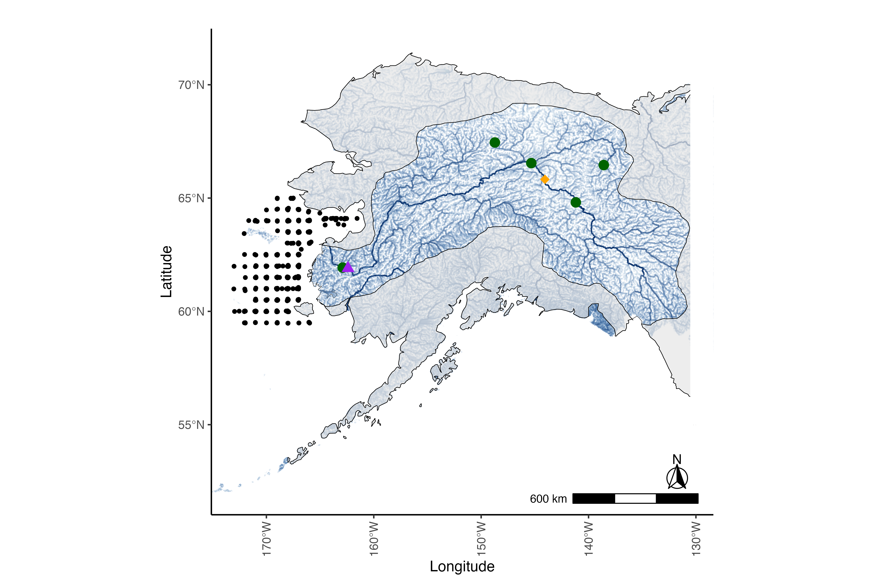
Notes:
Figure 1: Map of the Yukon River watershed, which includes Alaska, USA, and western Canada. The mask is highlighting the Yukon River watershed and associated tributaries, the mainstem of the Yukon River is the most prominent dark blue line and the green dots represent ADFG escapement project locations that were used as data in the Fall chum salmon run reconstruction. The black triangle represents Pilot Station, AK, the source of the USGS flow measurement station for the Yukon mainstem. The black gridded points represent survey stations for the NBS survey that collected information for the juvenile index and the stomach fullness index used in the IPM.

Slide 3
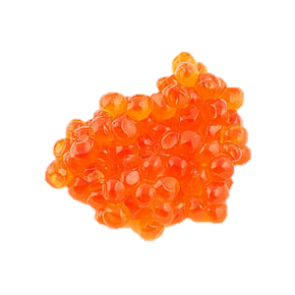
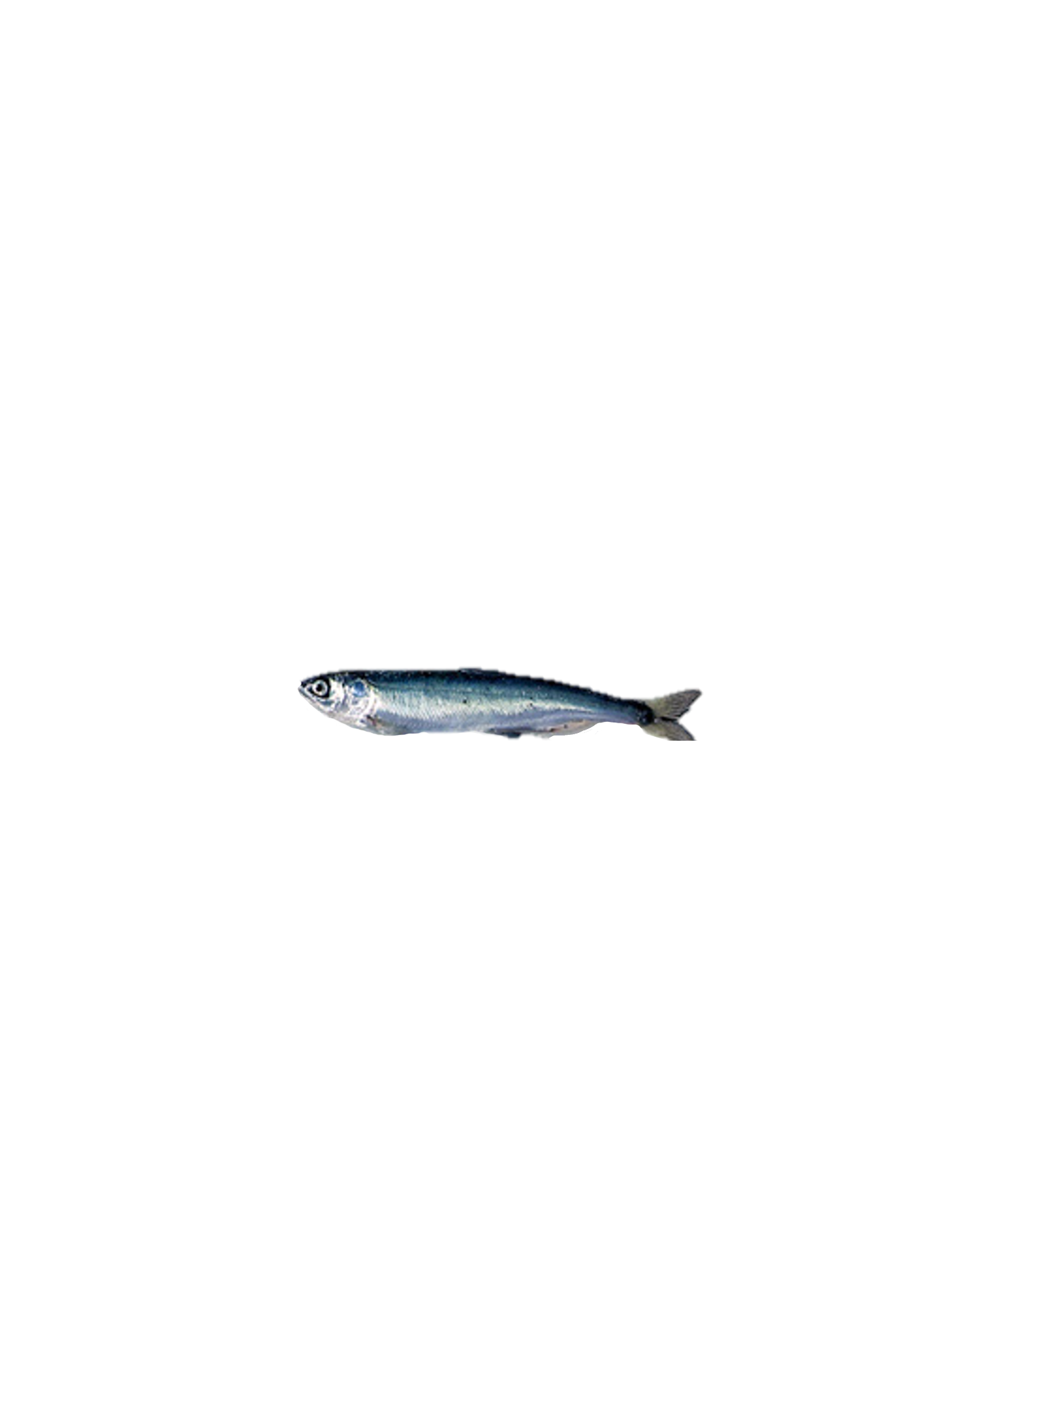
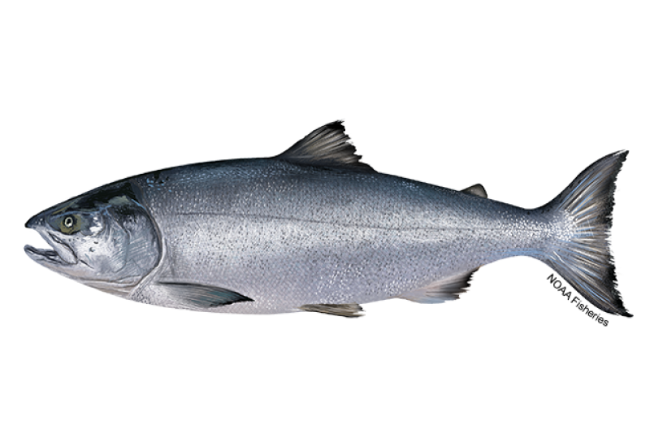
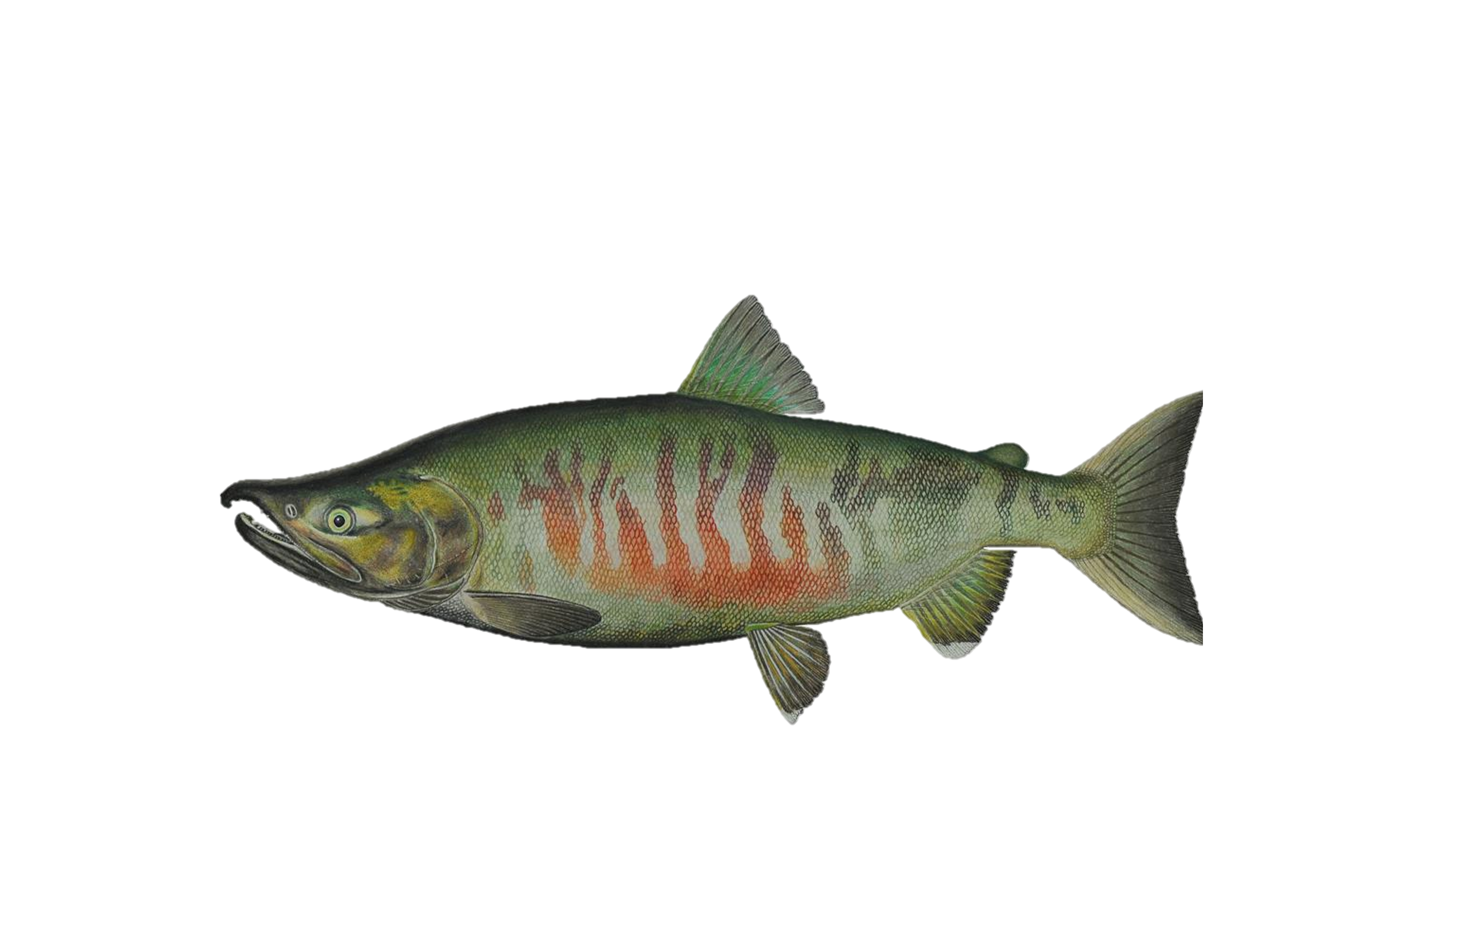
Fall Chum Integrated Population Model Structure
1.Eggs - N_{t,s=e}
Egg Abundance
Juvenile Survival Covariates (Stage 1-2)
1. Mean Spawner Size
ADFG Age Sex Length Database, Oke et al 2020
2. Winter Snowpack
Alaska Climate Research Center, Circle, AK
3. N Bering Sea Summer Cumulative Degree Days
AKFIN, NOAA
4. EBS Pollock Recruitment Index
Ianelli et al. 2024
2. Marine Juvenile - N_{t,s=j}
Abundance end of first summer at sea
NOAA/ADF&G, Cunningham et al.
3. Marine Immature - N_{t+1,s=m}
Abundance after first winter at sea
Marine Survival Covariates (Stage 2-3)
5. Stomach Fullness Index
NOAA, ADFG, NBS Surveys
6. Aleutian Cumulative Degree Days during 1st winter
AKFIN, NOAA
7. Chum hatchery salmon abundance
North Pacific Anadromous Fish Commission
4. Total Returns - N_{y,s=r,a}
Total Return Abundance
ADF&G, Fleischman & Borba 2009
5. Harvest - N_{y,s=h,a}
Terminal Harvest abundance
ADF&G, Fleischman & Borba 2009
Spawning
6. Spawners - N_{y,s=s,a}
Spawner Abundance
ADF&G, Fleischman & Borba 2009
Notes:
Figure 2: Schematic illustration of the Yukon River Fall Chum integrated population model, observational data and covariates included when estimating covariate effects on survival for respective life stages. Stages included in the model likelihood are numbered in orange, subscripts represent the brood year (t) or calendar year (y), the stage (s, e=eggs, j=juvenile, m=marine, r = recruit, h = harvest and s = spawner), and the age (a). The source of the data is included below the stage name. Covariates used to estimate survival included on the boxes on right hand side, orange indicates covariates included in the egg to juvenile abundance at the end of first summer stage (1- 2) and blue indicates covariates included in the juvenile abundance at the end of first summer stage to after the first winter at sea (2 - 3). Data sources are listed below the covariate and more covariate details are listed in Table 2, time series for each covariate provided in supplementary information.
** perhaps add survival variables for arrows/covariates

Slide 4
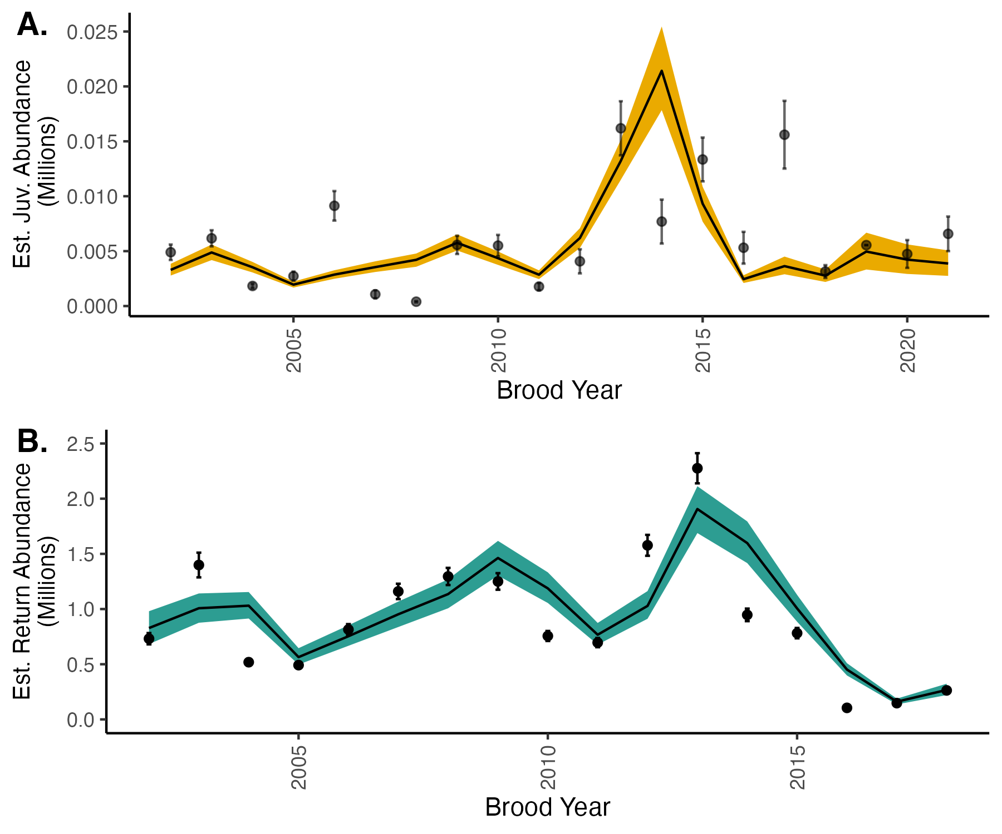
Notes:
Figure 3: Time series of indices used in the model likelihood inputs and model fits.
Points represent juvenile (a) and returning fish (b) indices used in the model likelihood while the lines represent the mean from estimated posterior distributions. Colored bands represent 95% credible intervals. The x axis represents the brood year, or the year when fish are in the egg stage. The NBS survey used to estimate the juvenile index did not occur in 2020 due to the global pandemic, so there is no juvenile index for brood year 2019.

Slide 5
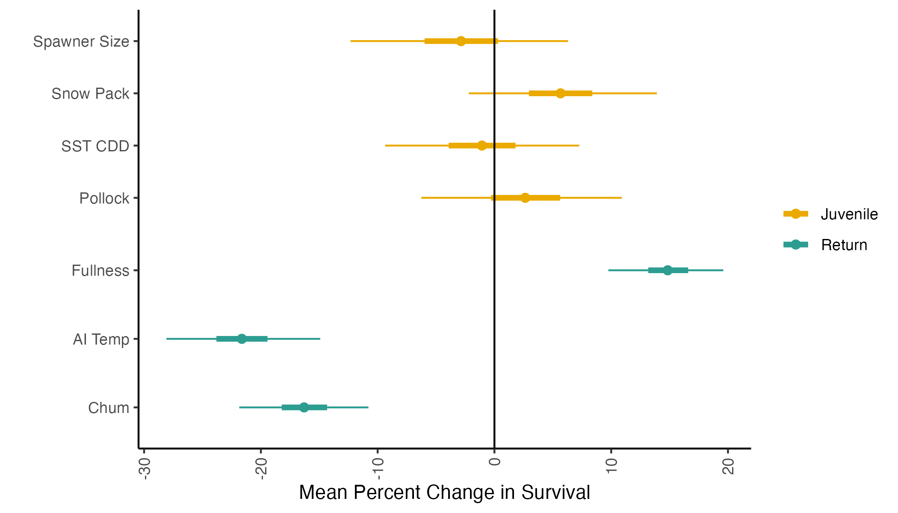
Notes:
Figure 4: Mean percent change in survival with an increase in 1 SD for each covariate. Estimates are based on covariate coefficients conditional on the carrying capacity and productivity rate without density dependence. Colors represent the life-stage where survival is estimated, informed by the respective covariate. Points represent mean estimates, thick lines represent 50% credible intervals and thin lines represent 95% credible intervals.

Slide 6
Supplementary Figures

Slide 7
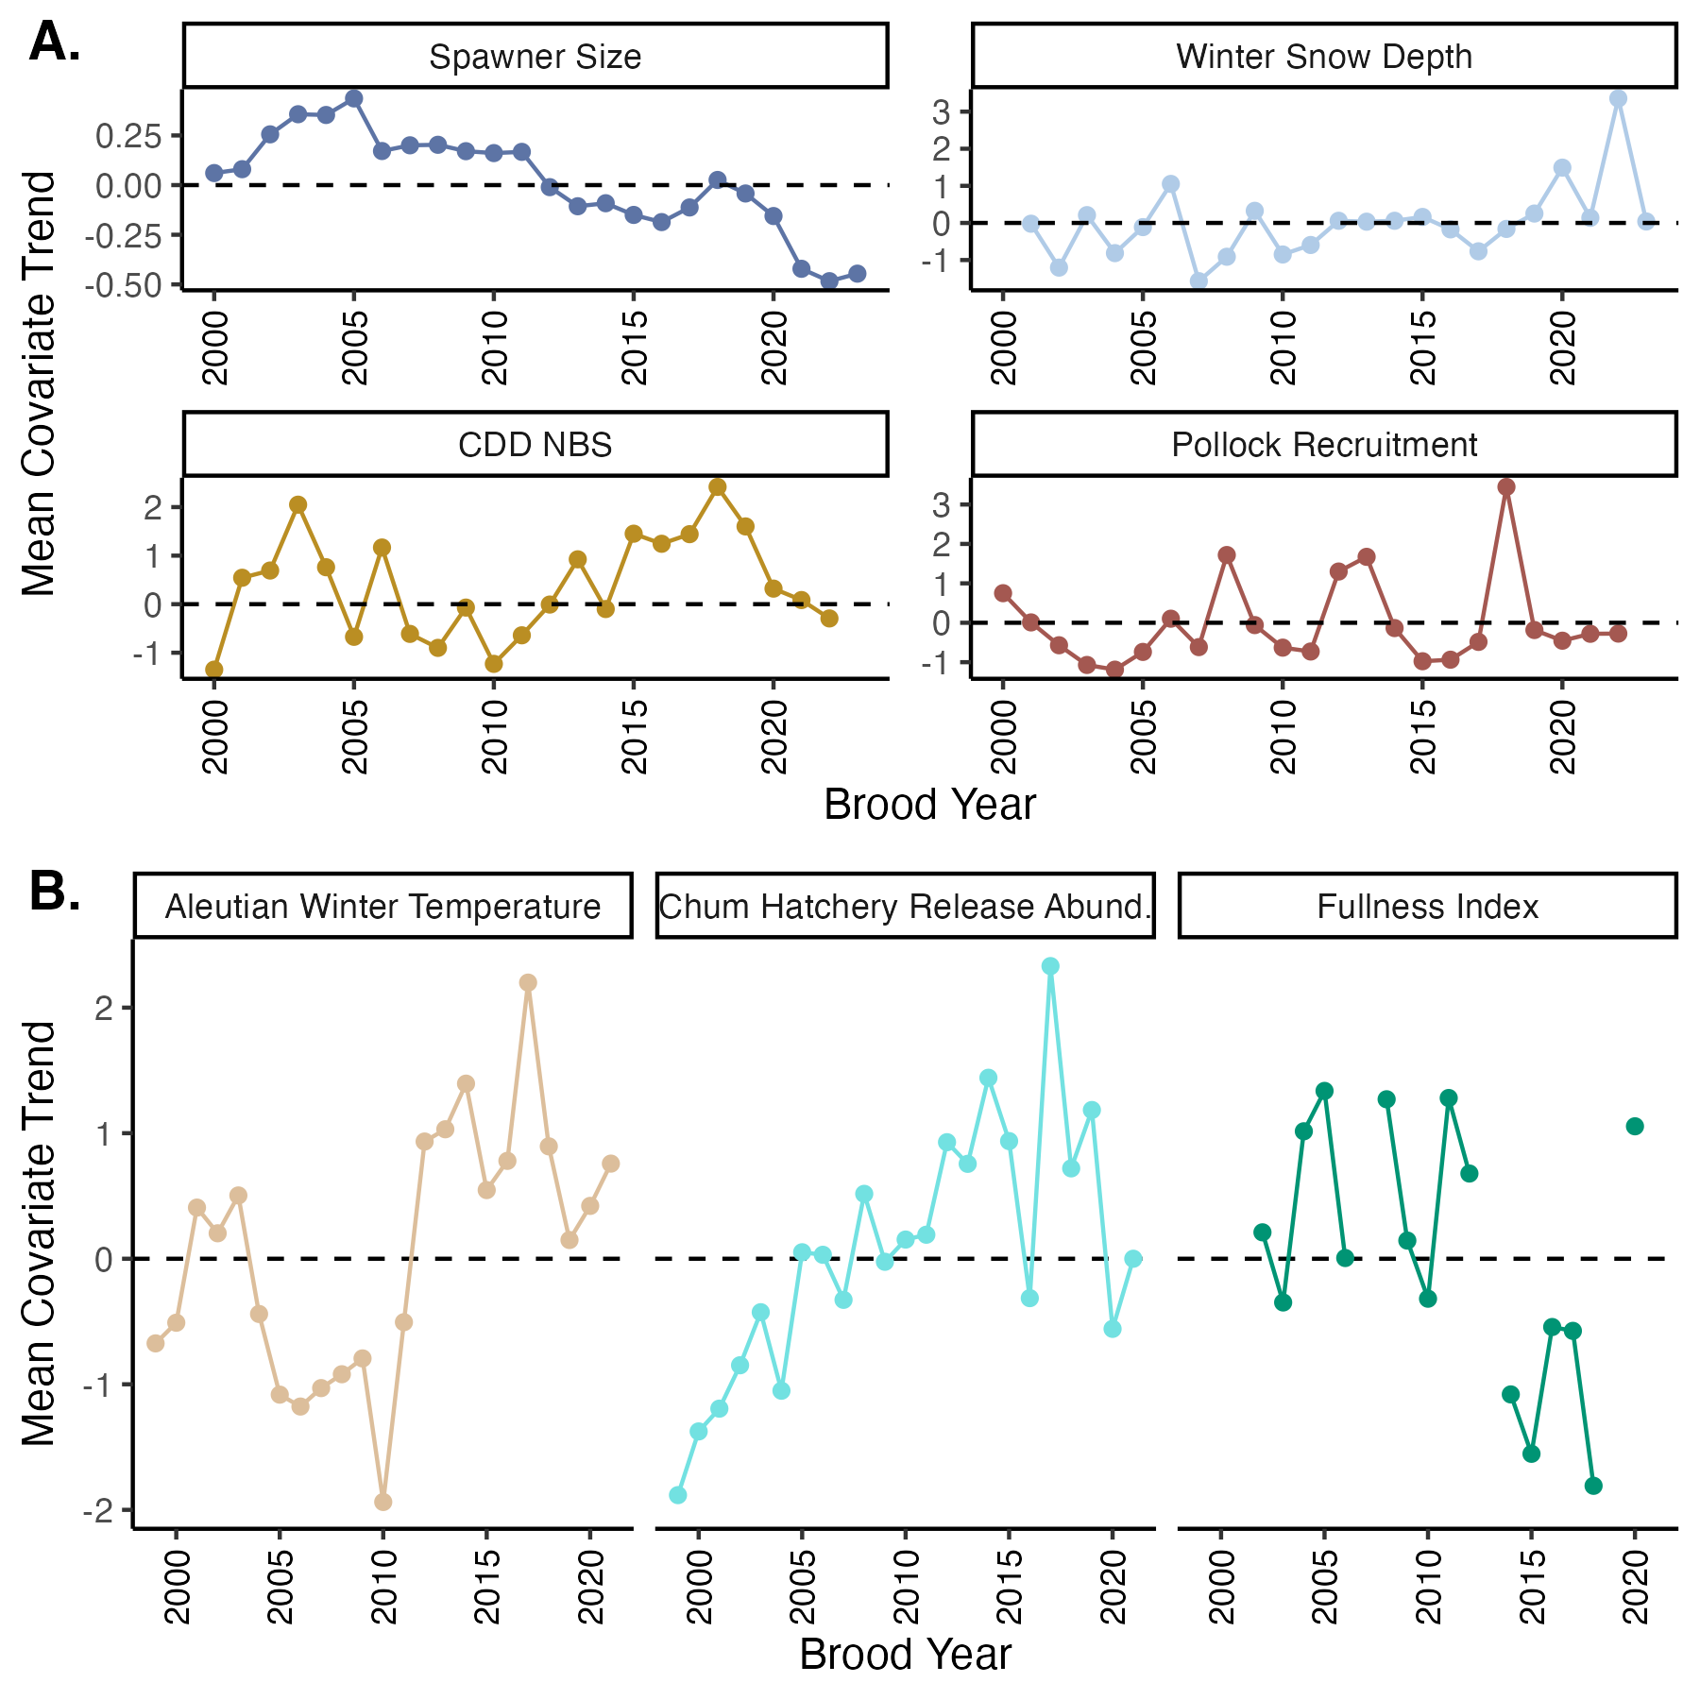
Notes:
Figure S1:
Mean-scaled covariate trends used in the IPM for the a) juvenile (egg to first summer at sea) and b) marine (first summer at sea to end of first winter at sea) stages.

Slide 8
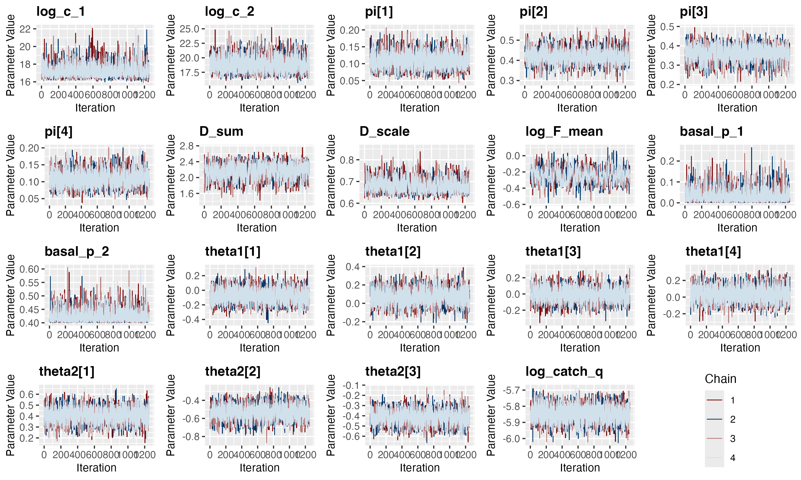
Notes:
Figure S2 – Trace plots used to identify model convergence for each for parameters. Four chains were run per model, dark shading background represents burn-in iterations.

Slide 9
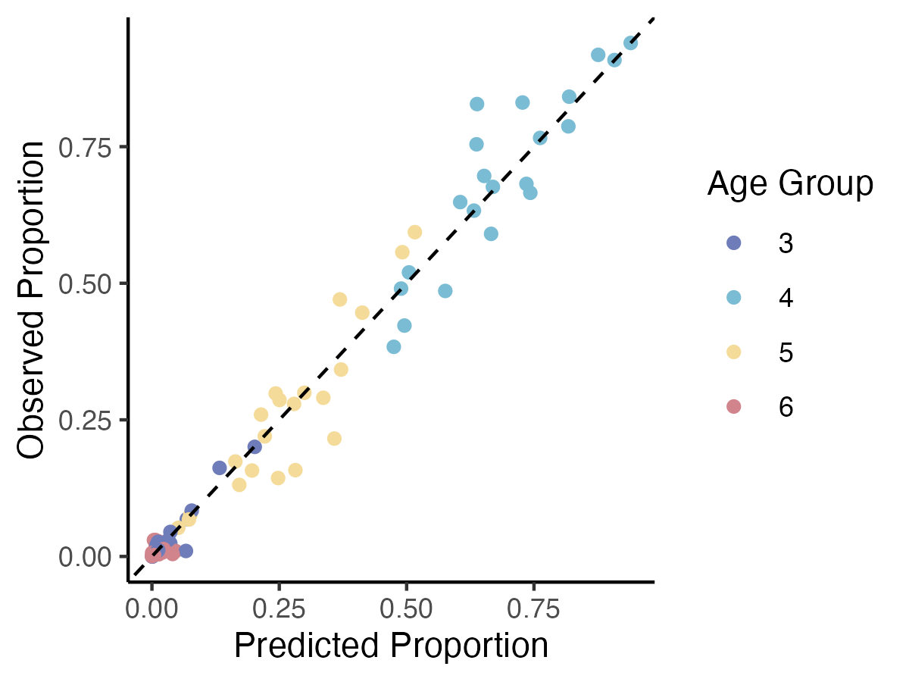
Notes:
Figure S3: Comparison of model predicted and observed age compositions, where each age represents a comparison for each calendar year and age class (ocean age). The dashed line represents a 1:1 comparison line, points that fall on the line are equal.

Slide 10
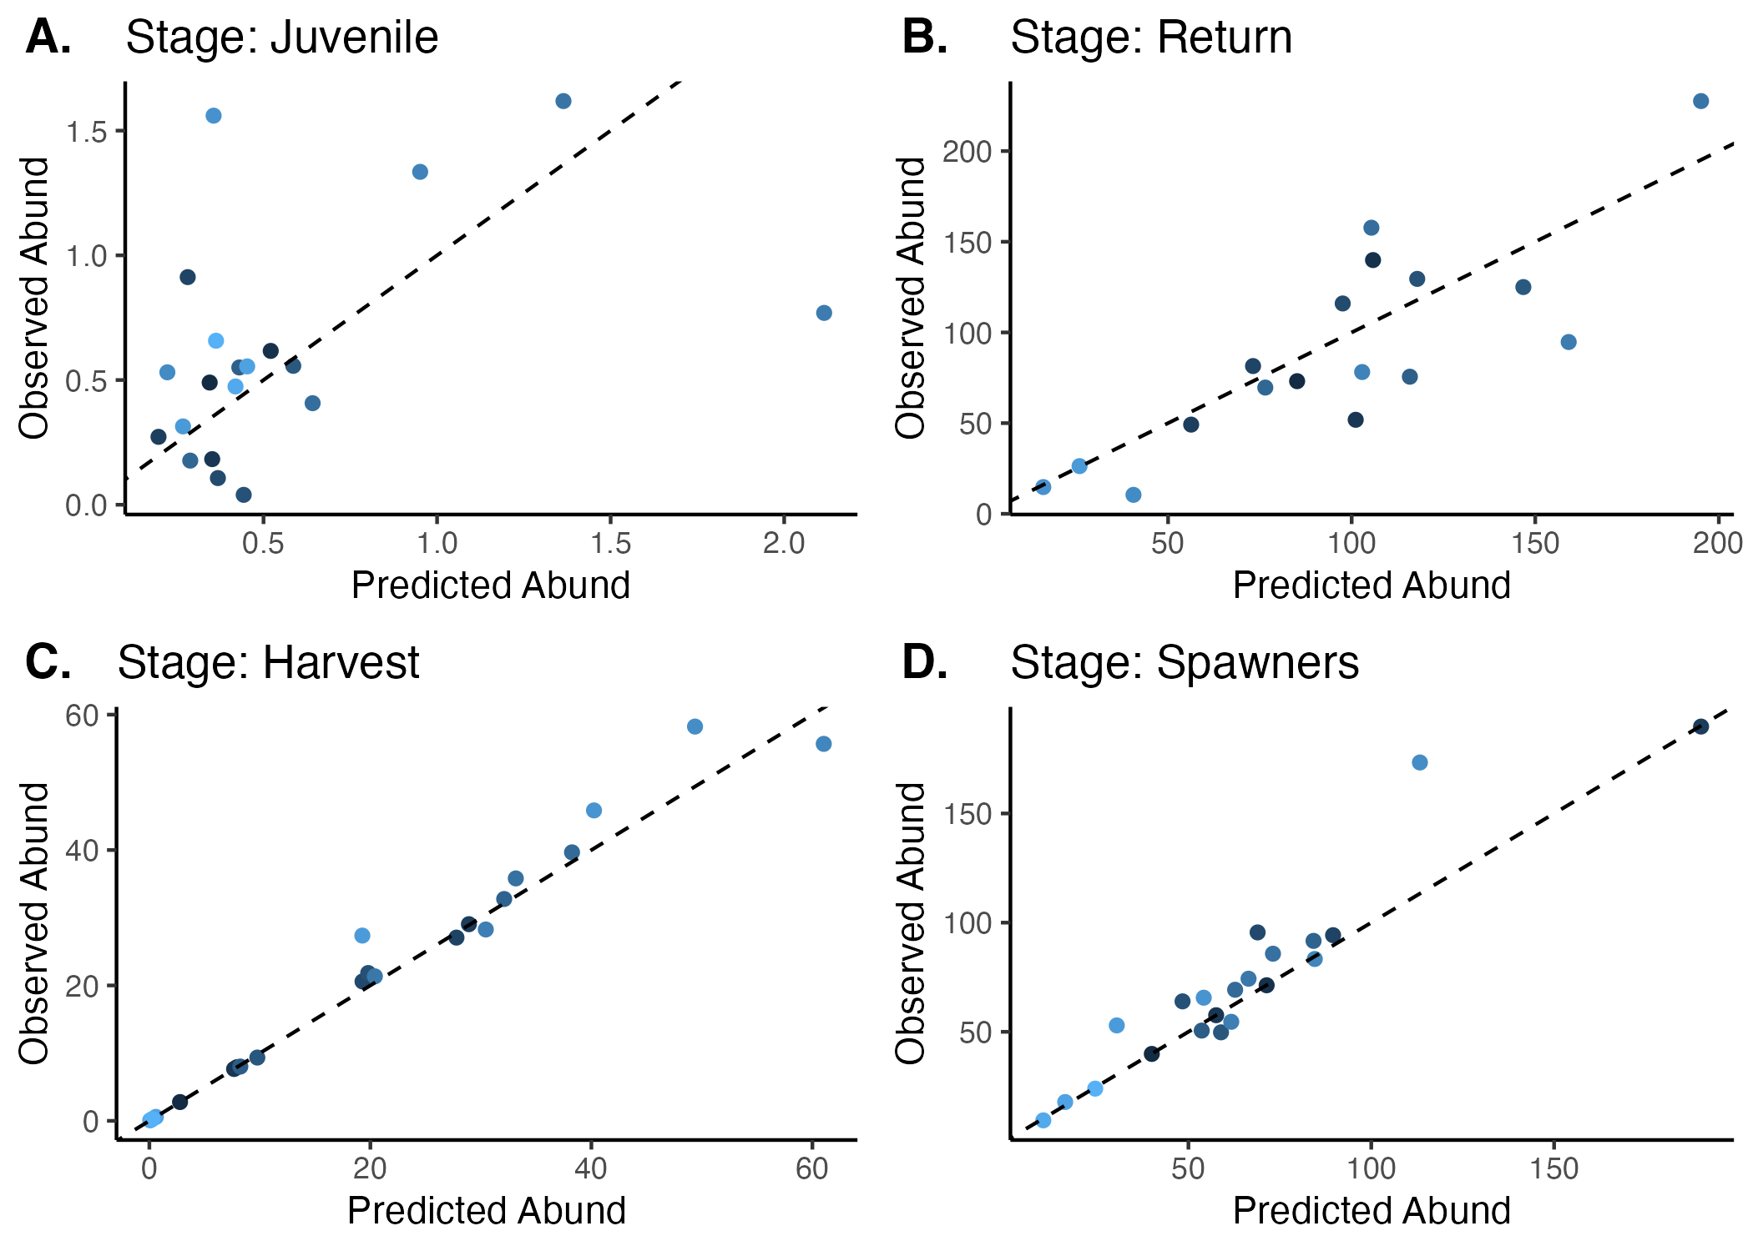
Notes:
Figure S4: Comparison of model predicted and observed abundances for a) Juveniles b) total returns c) harvest, d) spawner abundances. Each point represents a comparison for each calendar year and stage. The dashed line represents a 1:1 comparison line, points that fall on the line are equal. All abundances are in tens of thousands.

Slide 11
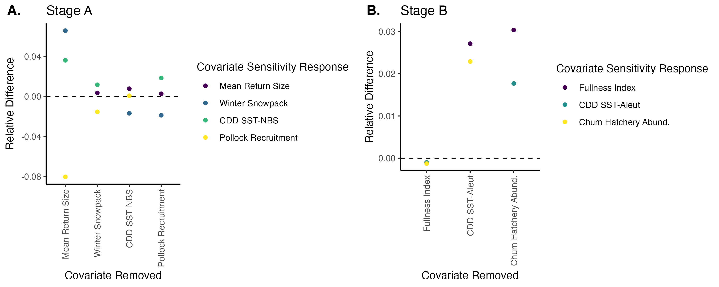
Notes:
Figure S5:
Results from covariate sensitivity testing. We calculated percent relative difference in covariate coefficients from the full model compared to a reduced model where one covariate removed at a time (covariate removed identified on x axis). The Y axis can be interpreted as the number of standard deviations higher or lower than the full model's estimate.

Slide 12
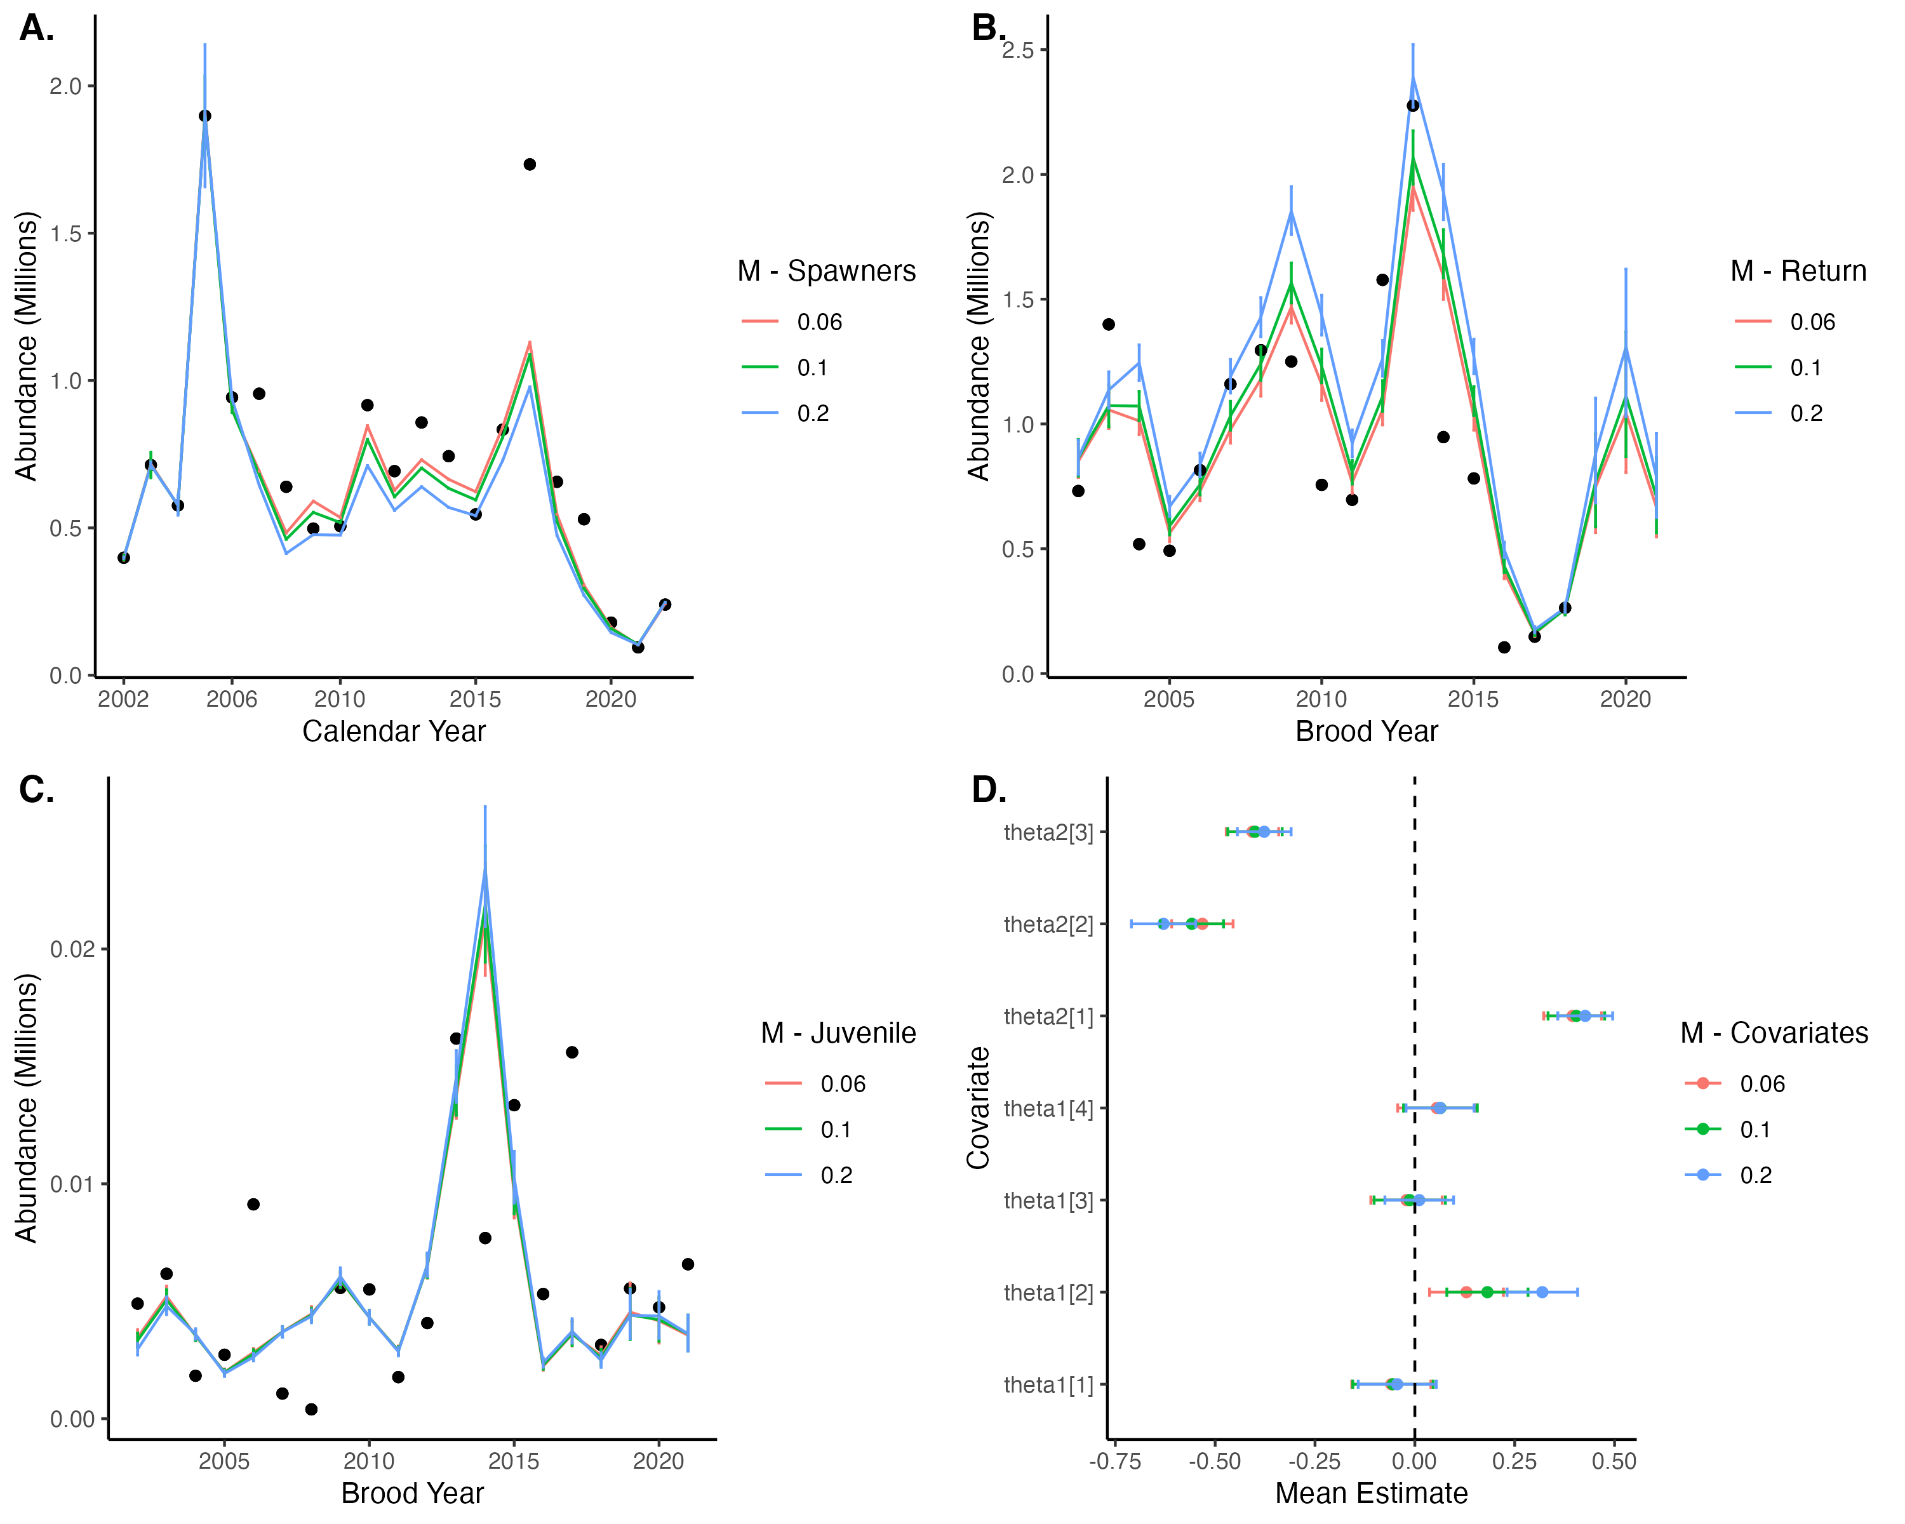
Notes:
Figure S6:
Results from mortality sensitivity testing for population estimates and covariate effect estimates.

